Slide 1


2G GSM Network
Presentation by Alaa Al-Taher,
Technical Support Practical Assignment

Slide 2
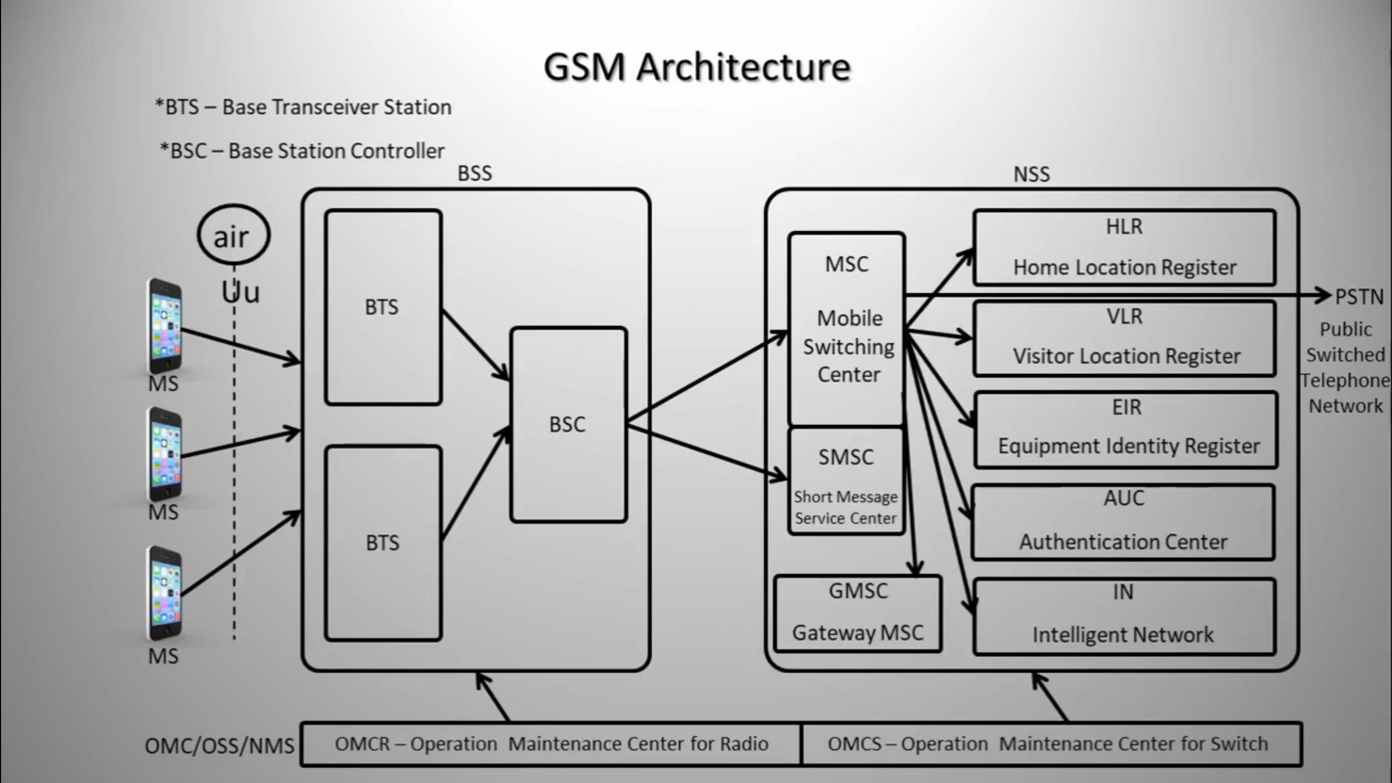

Slide 3
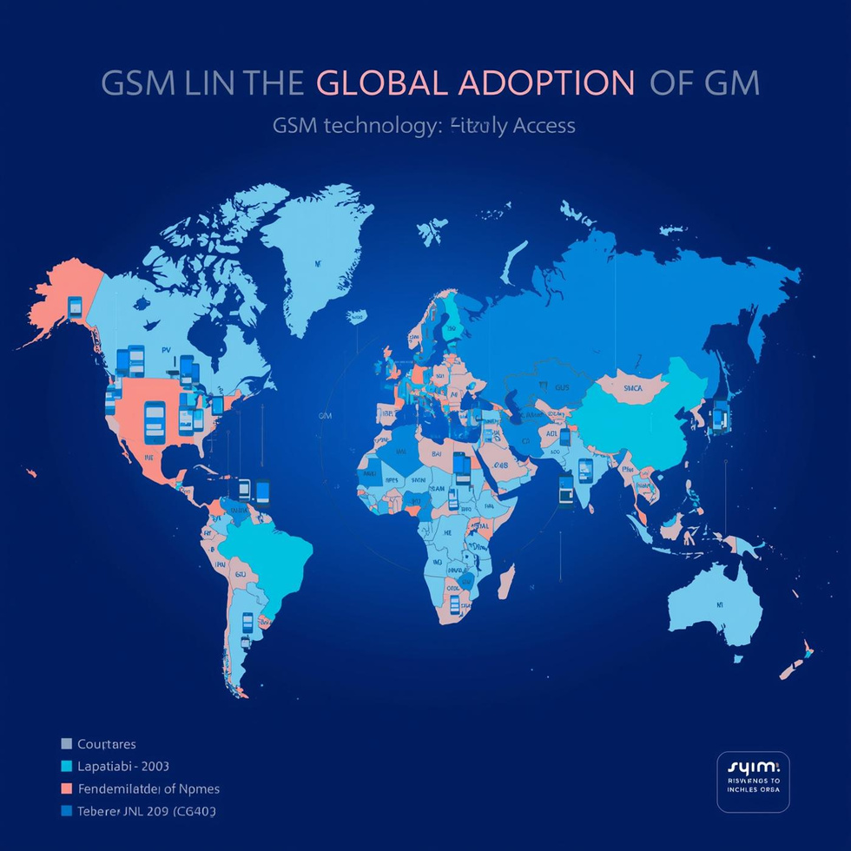
What is GSM?
The Global System for Mobile Communications (GSM) is a digital 2G technology that revolutionized mobile communication by enabling voice calls and SMS services. Launched in the early 1990s, it established a standard for mobile networks worldwide.
GSM's architecture allows for
1 seamless connectivity
2 efficient use of radio frequencies
making it an essential foundation for modern telecommunications.

Slide 4
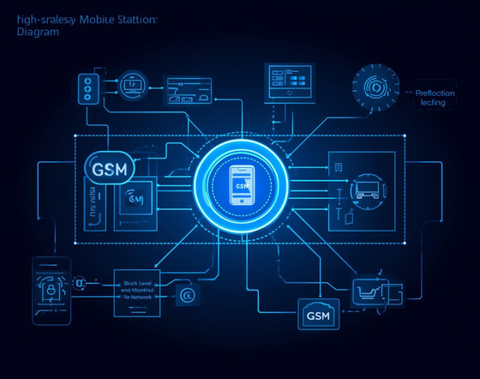
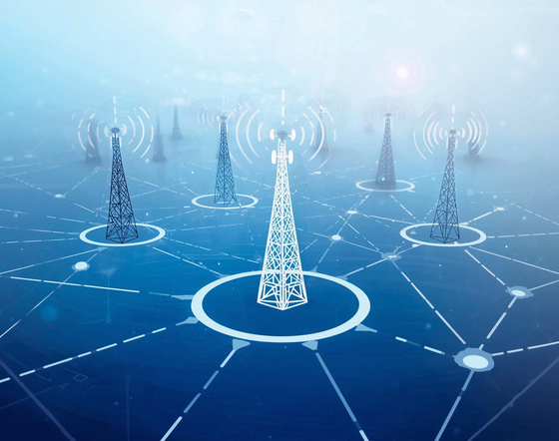
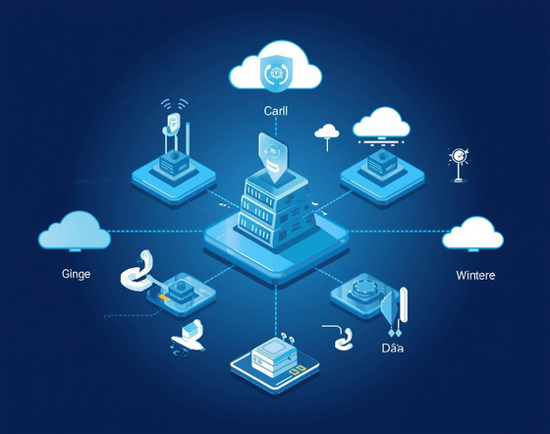
Overview of GSM Architecture Components
Mobile Station
Base Station Subsystem
Network Switching Subsystem
User device enabling voice and data services.
Connects user devices to the network core.
Core system managing call and data traffic.

Slide 5

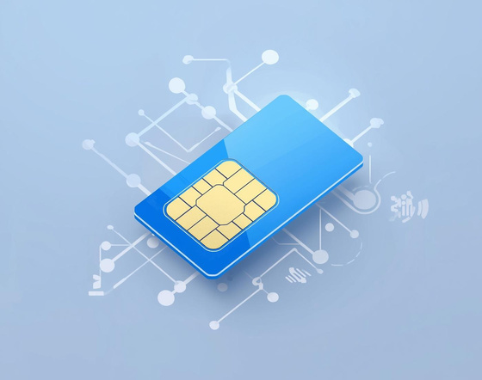

Understanding Mobile Station MS and SIM Functions
Mobile Station
Sim Unique Number
IMEI Identification
MS includes both the handset and SIM.
Number uniquely identifies each Sim Card .
IMEI Number uniquely identifies each mobile device.

Slide 6

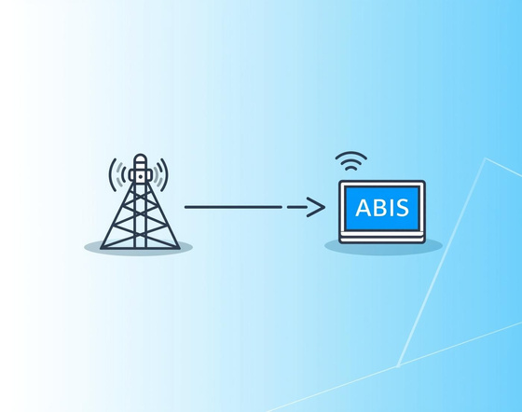

Understanding the
Base Transceiver Station (BTS)
In the BSS
Radio Transmission
Cell Coverage
BSC Connection
BTS handles all radio communications in its cell.
Provides connectivity for mobile devices within range.
Links to BSC via the Abis interface for management.

Slide 7
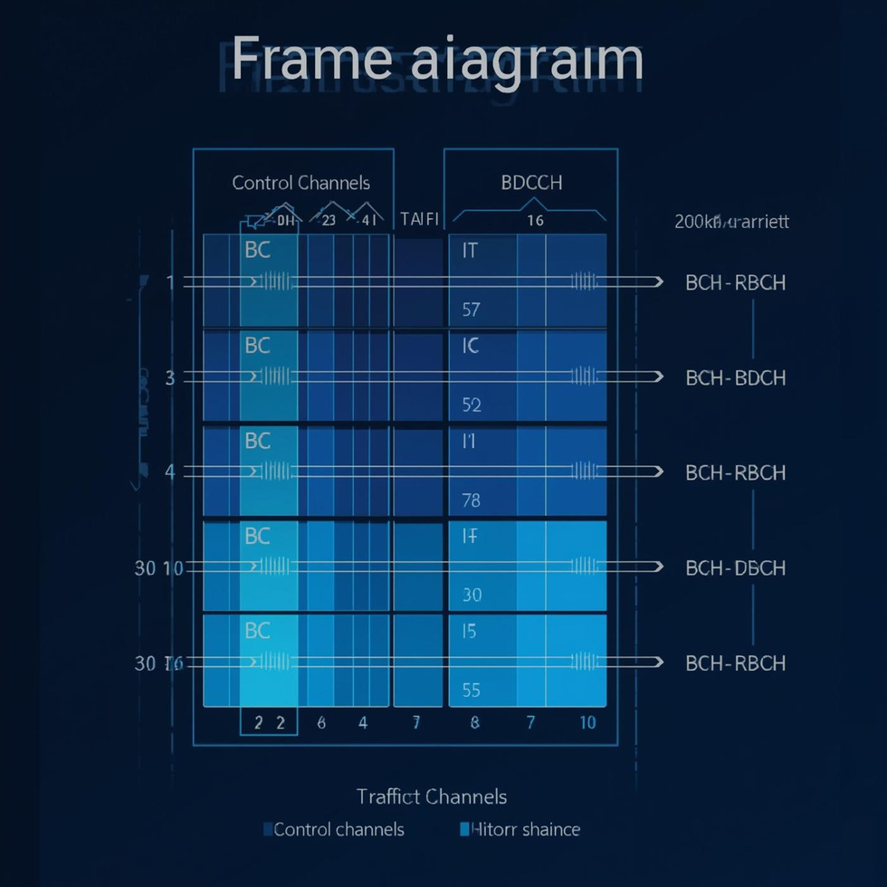
Radio Channels in BTS Base Transceiver
The GSM radio interface carriers divided into 8 time slots each on their frequency, facilitating efficient communication.

Slide 8
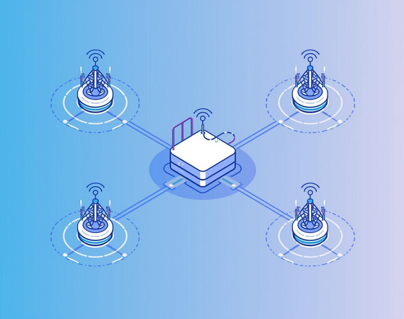
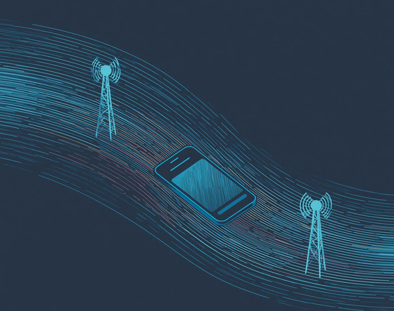
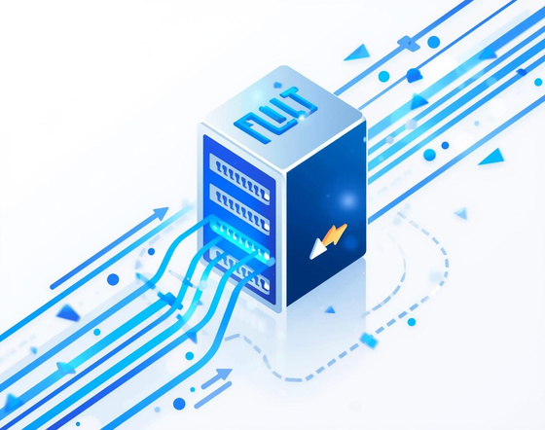
Base Station Controller and Packet Control (BSC)
In the BSS
Management
Handover
Packet Scheduling
Oversees connections and operations of multiple BTSs.
Facilitates seamless transitions between network cells.
Coordinates data traffic for efficient Quality

Slide 9
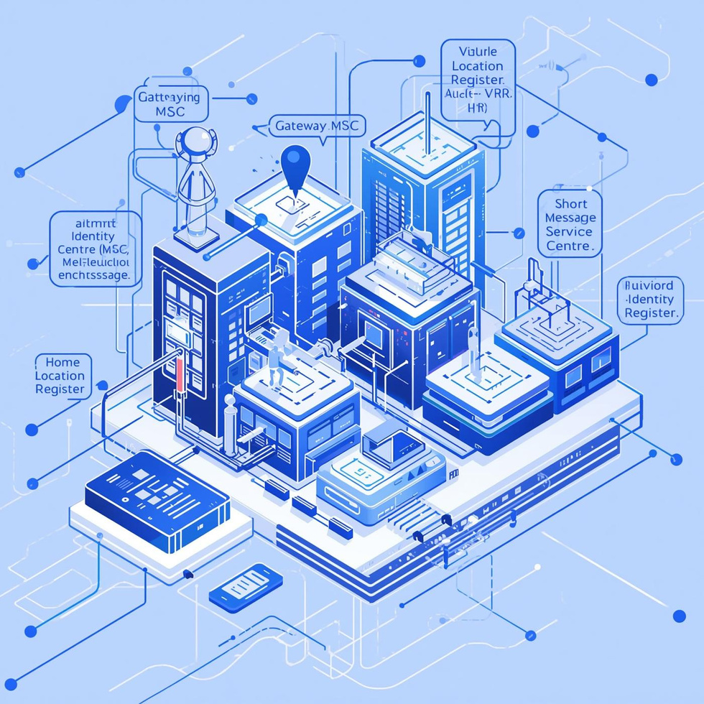
Network Switching
The Network Switching Subsystem (NSS) is vital for managing calls and mobility within the GSM network.
It includes several key components:
the Mobile Switching Centre (MSC) directs voice calls, while the
Home Location Register (HLR) and
Visitor Location Register (VLR):
maintain subscriber data.
Security features are handled by
the Authentication Centre (AuC) and
Equipment Identity Register (EIR), ensuring secure communication.

Slide 10
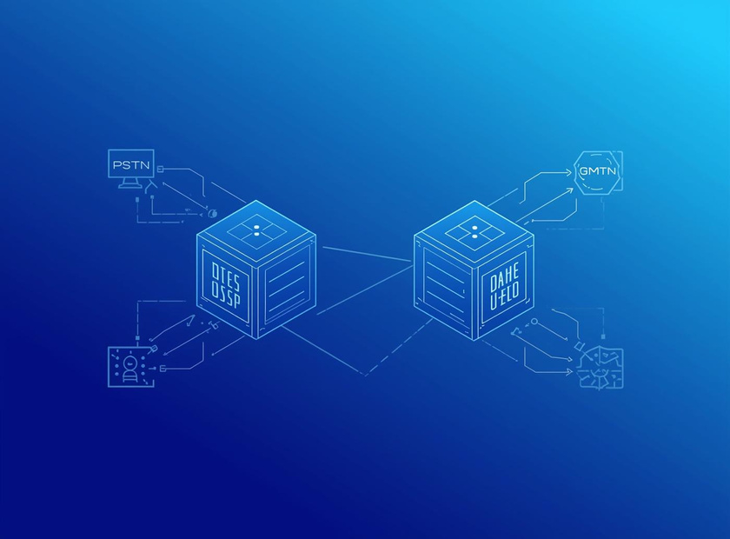
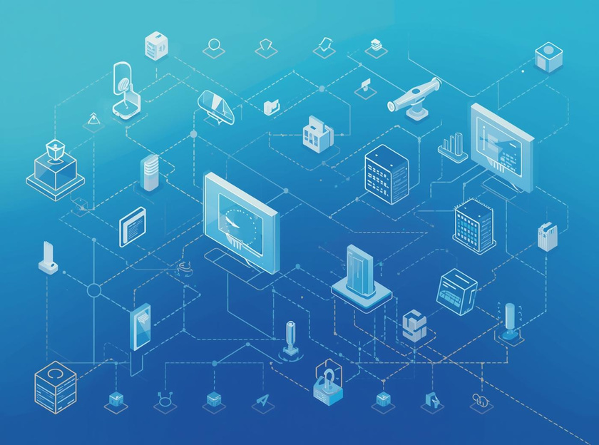
Mobile Switching Centre and Gateway MSC GMSC
Call Management
MSC efficiently manages calls and mobility tasks.
PSTN Connectivity
GMSC ensures seamless connectivity to external networks.

Slide 11
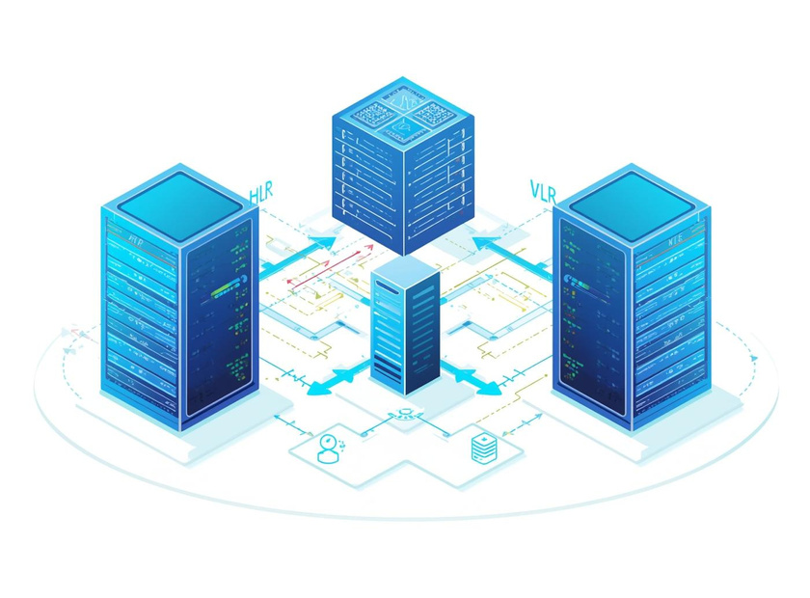
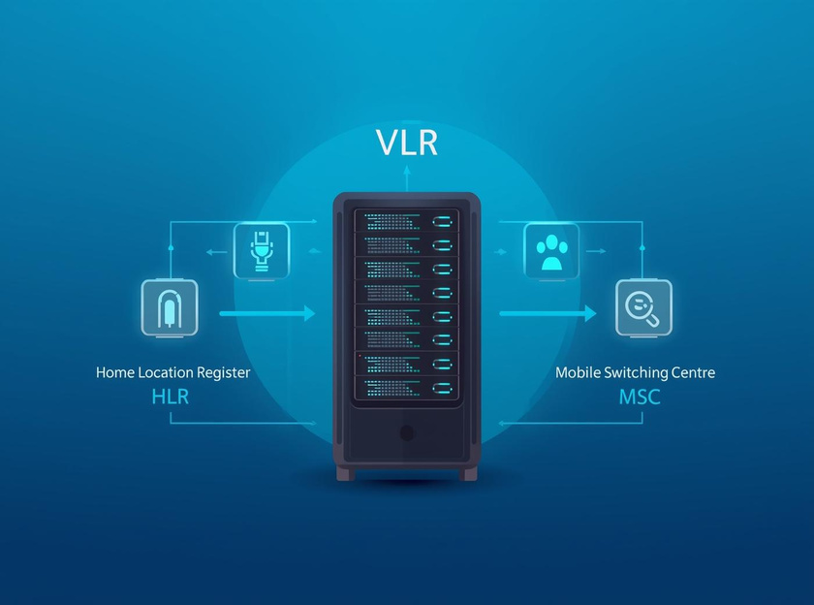
Home Location Register
HLR holds permanent subscriber data and services.
Subscriber Databases: HLR and VLR
Visitor Location Register
VLR manages temporary location data for users.

Slide 12


Authentication
AuC generates security triplets for verification.
Authentication and Equipment Databases Overview
Equipment Identity
EIR manages IMEI checks for device integrity.

Slide 13
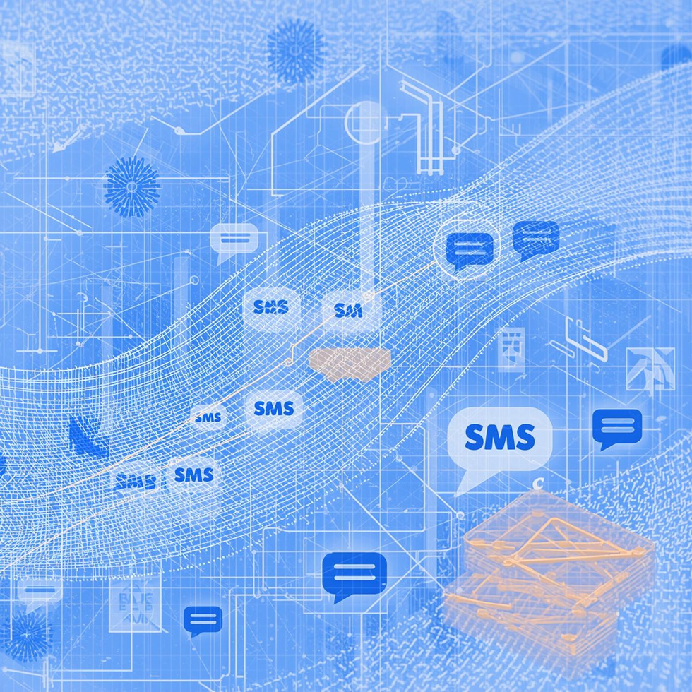
Short Message Service
The Short Message Service Centre (SMSC) is a critical component of the GSM network, responsible for storing and forwarding SMS messages. It facilitates the routing of messages via the Mobile Switching Centre (MSC) and Home Location Register (HLR), ensuring efficient delivery.

Slide 14

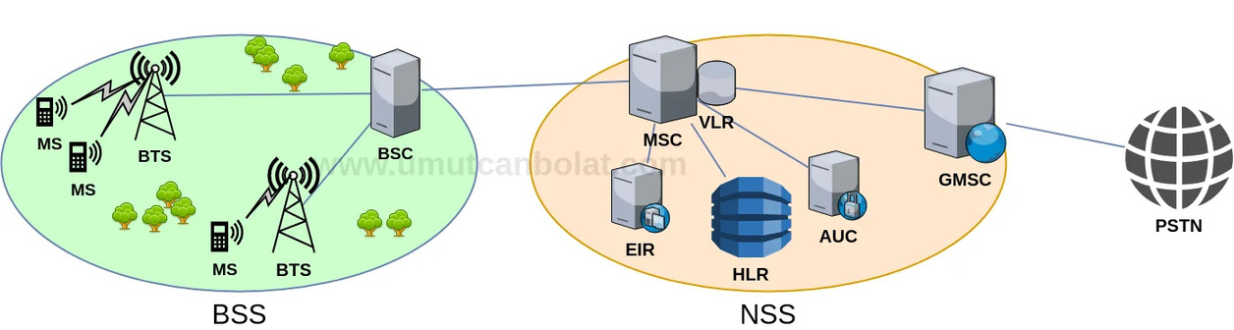
GSM Network Diagram
These diagrams illustrates the key components of a typical 2G GSM network and their interconnections. It includes the Mobile Station (MS), Base Transceiver Station (BTS), Base Station Controller (BSC), and Network Switching Subsystem (NSS). The labeled interfaces such as Abis, A, represent critical communication paths, demonstrating how each part collaborates to provide robust mobile communication.

Slide 15
Interfaces
01
A
02
Abis
The A interface links the Base Station Controller (BSC) to the Mobile Switching Centre (MSC) for call handling.
Abis connects the Base Transceiver Station (BTS) to the Base Station Controller (BSC), managing radio resources.

Slide 16

GSM
CORE CONCEPTS
Thank You for listening.
ANY QUESTIONS??
Alaa Al-Taher
0791916078
Alaa24Taher@gmail.com

